Slide 1


AiFi: AI-Enabled Interference Cancellation in WiFi Networks with Commodity PHY-Layer Information
Ruirong Chen, Kai Huang and Wei Gao
University of Pittsburgh
ACM SenSys 2022
Notes:
Hi everyone. I am Kai Huang from University of Pittsburgh. It’s my pleasure to present our work, “AiFi: AI-Enabled Interference Cancellation in WiFi Networks with Commodity PHY-Layer Information”. This is a joint work with my colleague Dr. Ruirong Chen, and my advisor Dr. Wei Gao at University of Pittsburgh.

Slide 2
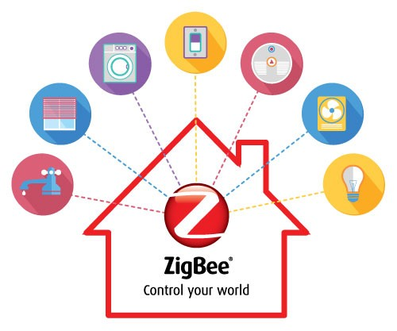

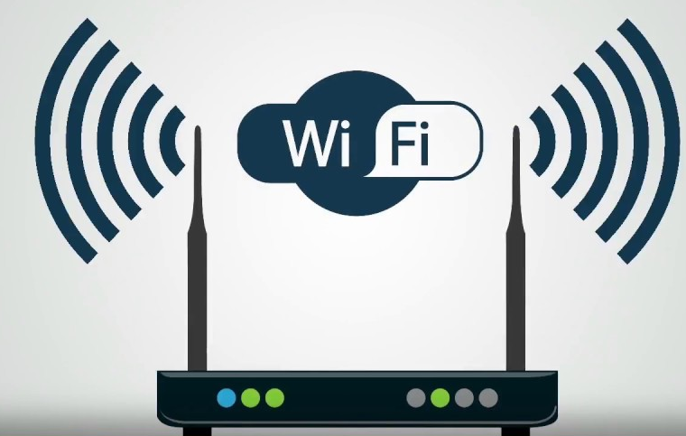
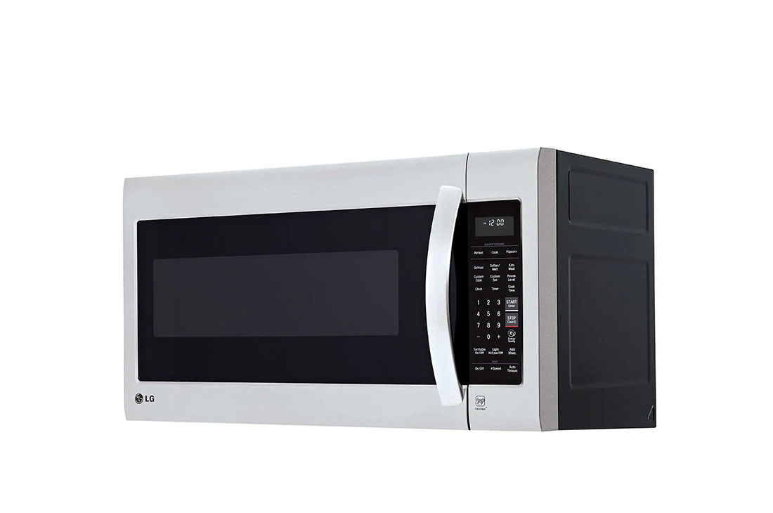

Interference in Unlicensed Wireless Bands
WiFi
Zigbee
Bluetooth
And more …
Baby Monitor
Microwave
Notes:
Nowadays, with the growth of wireless device population and large diversity of wireless technologies, many devices and wireless technologies transmit simultaneously in the same unlicensed WiFi band.
This causes signal interference and greatly reduces network performance.

Slide 3



Solutions to Interference: Collision Avoidance (CSMA/CA)
Wireless channel
I am accessing the channel
Transmitting
Listens
Channel occupied
I will back off
>200ms Delay
Set up a back off timer
Notes:
Most commodity WiFi networks address interference using collision avoidance,
[x] where each device detects channel occupancy by carrier sensing, and avoids interference by postponing the forthcoming transmission if the channel is occupied.
[x] But such schemes introduce a significant transmission delay due to the long backoff time period.

Slide 4







Solutions to Interference: Interference cancellation
Rx
Tx
Received: S + $I$
Signal S
Remove $I$
Additional antenna
Received: $I$
Probe $I$
Requires extra RF hardware
Interference $I$
Notes:
Instead, to avoid long additional delay, later research efforts focus on interference cancellation,
[x] which uses additional RF hardware to probe the interference signal
[x] and then removes such interference from the received signal.
However, note that commodity MIMO systems cannot be used for such probing and cancellation, because MIMO antennas can only be all set to either Tx or Rx mode.
As a result, most existing schemes require custom RF hardware and cannot apply to commodity WiFi devices.

Slide 5
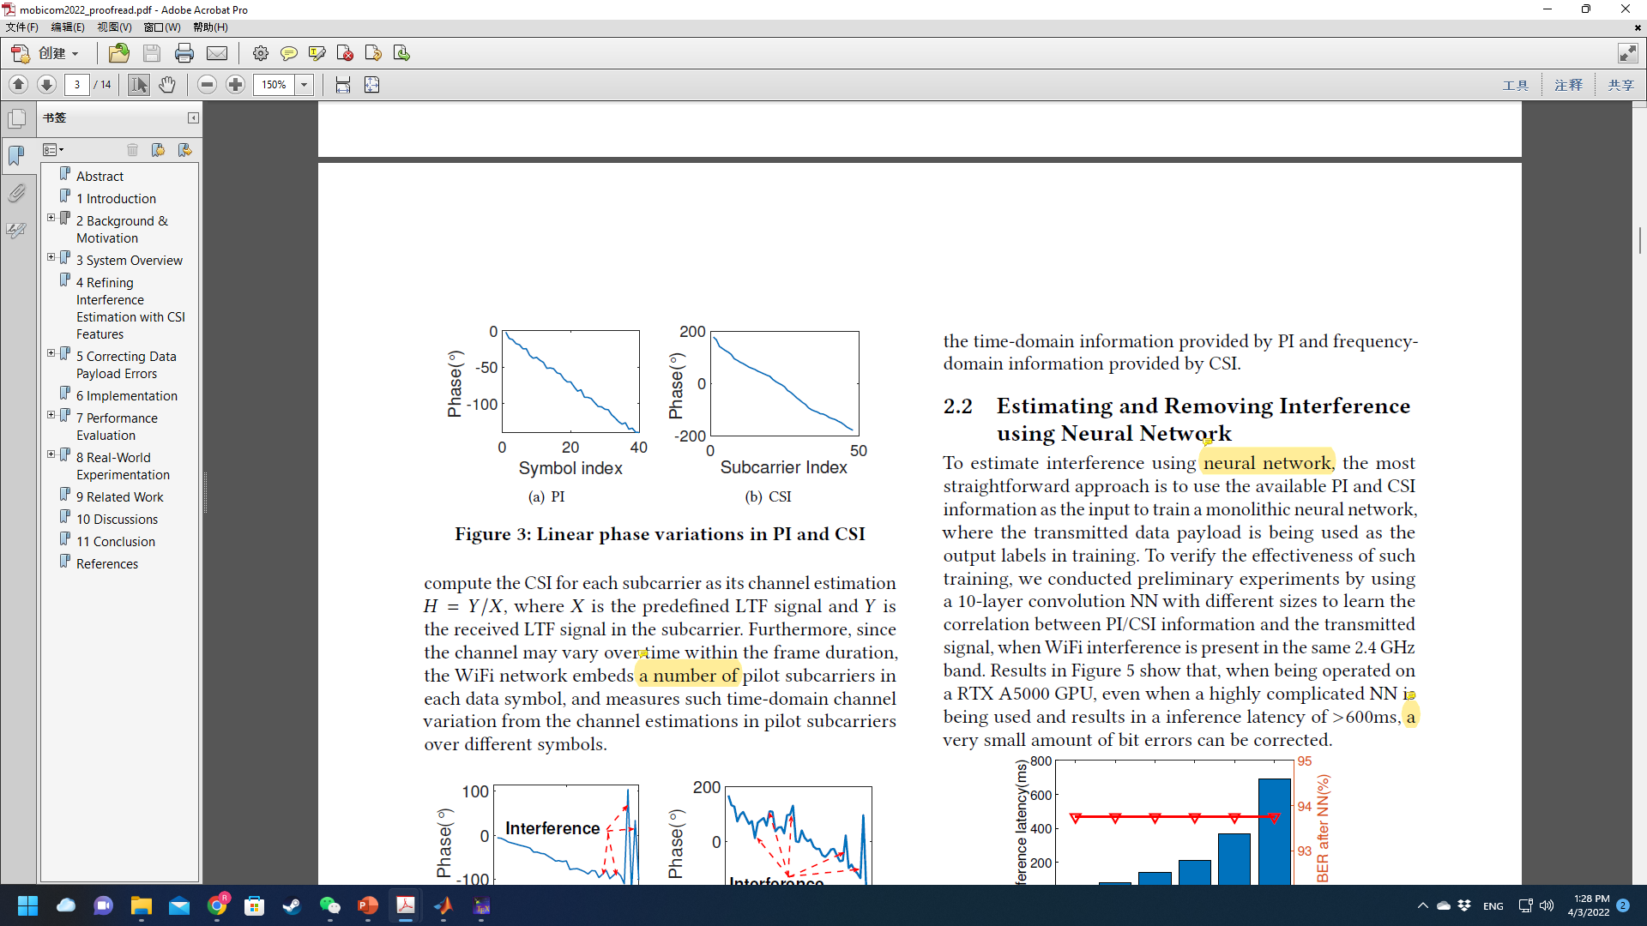
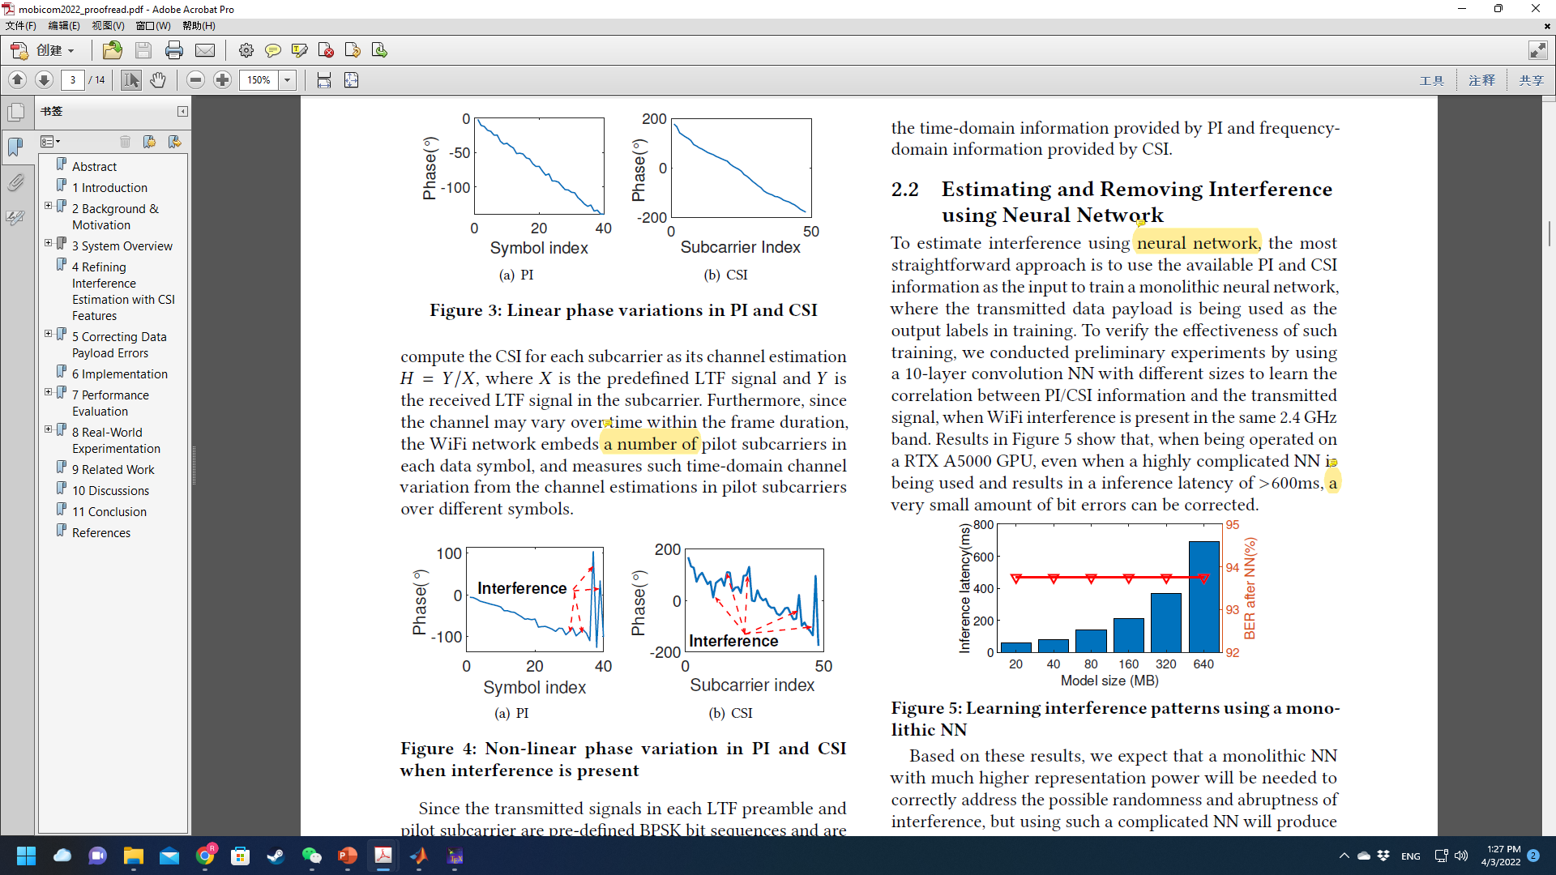



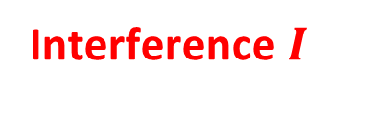


Our Key Insight: WiFi Interference Cancellation with Local PHY Information instead of extra RF hardware
Received
$$I$$
Interference $I$
Pilot/CSI Info =
Standard
t
Regression
Interference I
Standard
$$I_{C}$$
$$I_{P}$$
$$I_{P}$$
Preamble
CSI Info
Interfered
Data
Pilot
Pilot Info
Interfered
…
…
$$I_{C}$$
Pilot
Data
f
Subcarriers
Standard
Challenge: How to precisely estimate interference from CSI and PI information?
Notes:
To address these limitations, we envision that, instead of using extra RF hardware, the knowledge about interference can be retrieved from the [x] local physical layer information on commodity WiFi devices.
[x] More specifically, such physical layer information include the pilot and CSI information. When interference exists, the pilot and CSI info is calculated as the difference between those in the received signal and those in non-interfered signal.
[x] AiFi first calculates the interference knowledge in pilot subcarriers, by comparing the interfered pilot signal’s phase with that of standard pilot signal.
[x] [x] Afterwards, AiFi applies such knowledge to estimating and removing the interference in nearby data subcarriers by regression.
[x] and we utilize CSI information to provide more fine-grained frequency domain knowledge about interference for the regression.
[x] However, the key challenge of this approach is the high dynamics and uncertainty of the interference signal. How can we make sure that such interference can be precisely estimated from the CSI and PI information and then completely removed from the received signal?

Slide 6
Our Design of AiFi: Use Neural Networks to Mimic WiFi PHY Processing
WiFi PHY Processing
Channel estimation
Equalization
Demodulation
Decoding
Inputs
Feature Extraction
1. Interference Estimation
3. Data Payload Correction
Non-interfered CSI
Interference
Features from CSI
Data signal features
Interfered CSI
Refinement NNs
Non-interfered PI
Payload correction NN
Interference
Features from PI
Regression NN
Demodulation NN
Estimated interference
Interfered PI
2. Interference Removal
Interfered signal
Corrected data payload
Fully connected NN
All the NN modules are trained in an end-to-end manner with a unified cross-entropy loss function.
Notes:
To ensure the accuracy of interference cancellation, our basic idea is to leverage the power of neural networks, but intentionally let the neural networks to mimic the physical layer operations of commodity WiFi with individual NN modules.
[x] [x] AiFi first extracts the interference features from the pilot and CSI information, and then uses these features to estimate interference in each individual data subcarrier through regression and refinement based on attention NNs, which mimic the WiFi channel estimation.
[x] Second, AiFi removes such interference from the received signal. It mimics the WiFi’s equalization process in the feature space by using a fully connected NN.
[x] After that, AiFi further corrects data encoding errors across multiple data subcarriers, by using an LSTM network to mimic the WiFi data encoding and decoding.
Finally, AiFi uses a demodulation network to transform the corrected data payload from feature space to actual data bits.

Slide 7
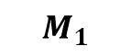
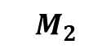
1. Interference Estimation
Regression NN
Attention based structure
Intermediate grid
Output
Estimated interference
0 | 0 | 0 | 0 | 0 | 0 | 0
 | 0 |  | 0 |  | 0
0 | 0 | 0 | 0 | 0 | 0 | 0
PI Features (M₁)
PI
Dense
Concatenate
Refinement NN
Weight matrix
Feature Refinement NNs
Scale + softmax
CSI Features (M₂)
Dense
Dense
Dense
$$M_{1}$$
$$M_{2}$$
Key features
Key interference features
Refined interference
Notes:
In interference estimation, the interference features from Pilot and CSI information are first extracted with convolutional NNs.
[x] The features from Pilot are further expanded to an intermediate grid by zero padding,
[x] and then we slide a trainable filter over it to interpolate this grid. The filter exploits the continuity in the interference between consecutive data subcarriers.
[x] To further refine the estimated interference in Pilot using CSI, we train a refinement NN.
[x] The refinement NN adopts attention-based structure. It takes the Pilot and CSI interference features as two input masks to compute a correlation matrix. And use this correlation matrix to weight the pilot features to get the refined features.

Slide 8
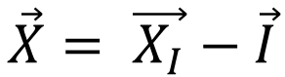
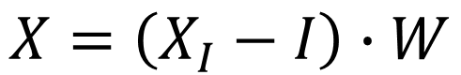
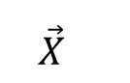
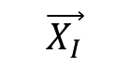

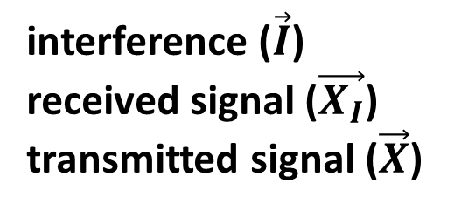
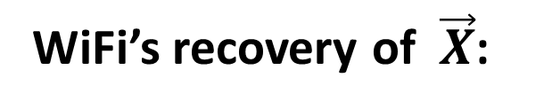
2. Interference Removal
Q
interference ($\vec{I}$)
received signal ($\vec{X_{I}}$)
transmitted signal ($\vec{X}$)
$$\vec{I}$$
WiFi’s recovery of $\vec{X}$:
$$\vec{X}$$
$$\vec{X_{I}}$$
$$\vec{X}= \vec{X_{I}}−\vec{I}$$
I
AiFi mimics it with a fully-connected NN in feature space
Learnable weights
$$X=\left(X_{I}−I\right)∙W$$
Notes:
After having estimated the interference in a data subcarrier, we then remove it from the received signal by mimicking the WiFi channel equalization process.
The standard equalization process intends to remove the interference by subtracting the estimated interference from the received signal in constellation diagram.
[x] Given the estimated interference features, AiFi mimics such equalization in the feature space with a fully-connected NN.
However, the interference removal may not completely remove the bit errors in data payloads across multiple subcarriers due to limit signal resolution in CSI and Pilot information.

Slide 9
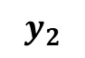
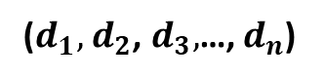
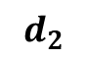
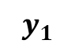
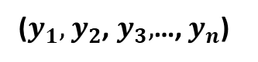
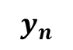
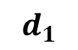
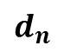
3. Data Payload Correction
Commodity WiFi encoder
Only consider short-term correlation
Data payload
01
11
11
State
000000
000001
…
111111
Input bits
1
0
1
AiFi mimics the WiFi encoding/decoding
AiFi design
($y_{1},$ $y_{2}$, $y_{3},$…, $y_{n}$)
$$y_{1}$$
$$y_{2}$$
$$y_{n}$$
Expand
Repeat
LSTM cell
LSTM cell
…
LSTM cell
LSTM cell
($d_{1},$ $d_{2}$, $d_{3},$…, $d_{n}$)
$$d_{1}$$
$$d_{2}$$
$$d_{n}$$
Neighbor data
Memorizing long-term interdependencies
Notes:
To further correct bit errors, AiFi captures the coding correlation within the data payloads in multiple subcarriers and uses such correlation knowledge for data payload correction.
[x] In comparison, commodity WiFi encoder only considers the short-term correlation between input bits, but cannot capture the long-term dependencies.
[x] Instead, AiFi uses an LSTM network to memorize both the short-term and long-term dependencies with a memory cell. It shares the similar structure with the state machine in WiFi encoder and can correct the bit errors by regression based on memorized dependencies.

Slide 10
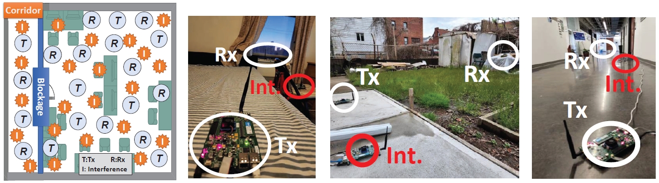
Implementation and Evaluation setup
AiFi is implemented with TensorFlow 2.0 python APIs and C APIs.
The NN training is done over 300k WiFi frames collected with different interference scenarios
All the results are averaged over 10k interfered WiFi frames in inference
Training environment
Multiple testing environments
Notes:
In implementation, we leverage the WiFi reference design of commodity WiFi g standard on the WARP SDR to transmit and receive wireless signals in the air, and obtain Pilot and CSI information from the WiFi physical layer.
We collect training data over multiple interference scenarios in the lab environment, and then test the performance of AiFi in room, corridor and outdoor environments.

Slide 11
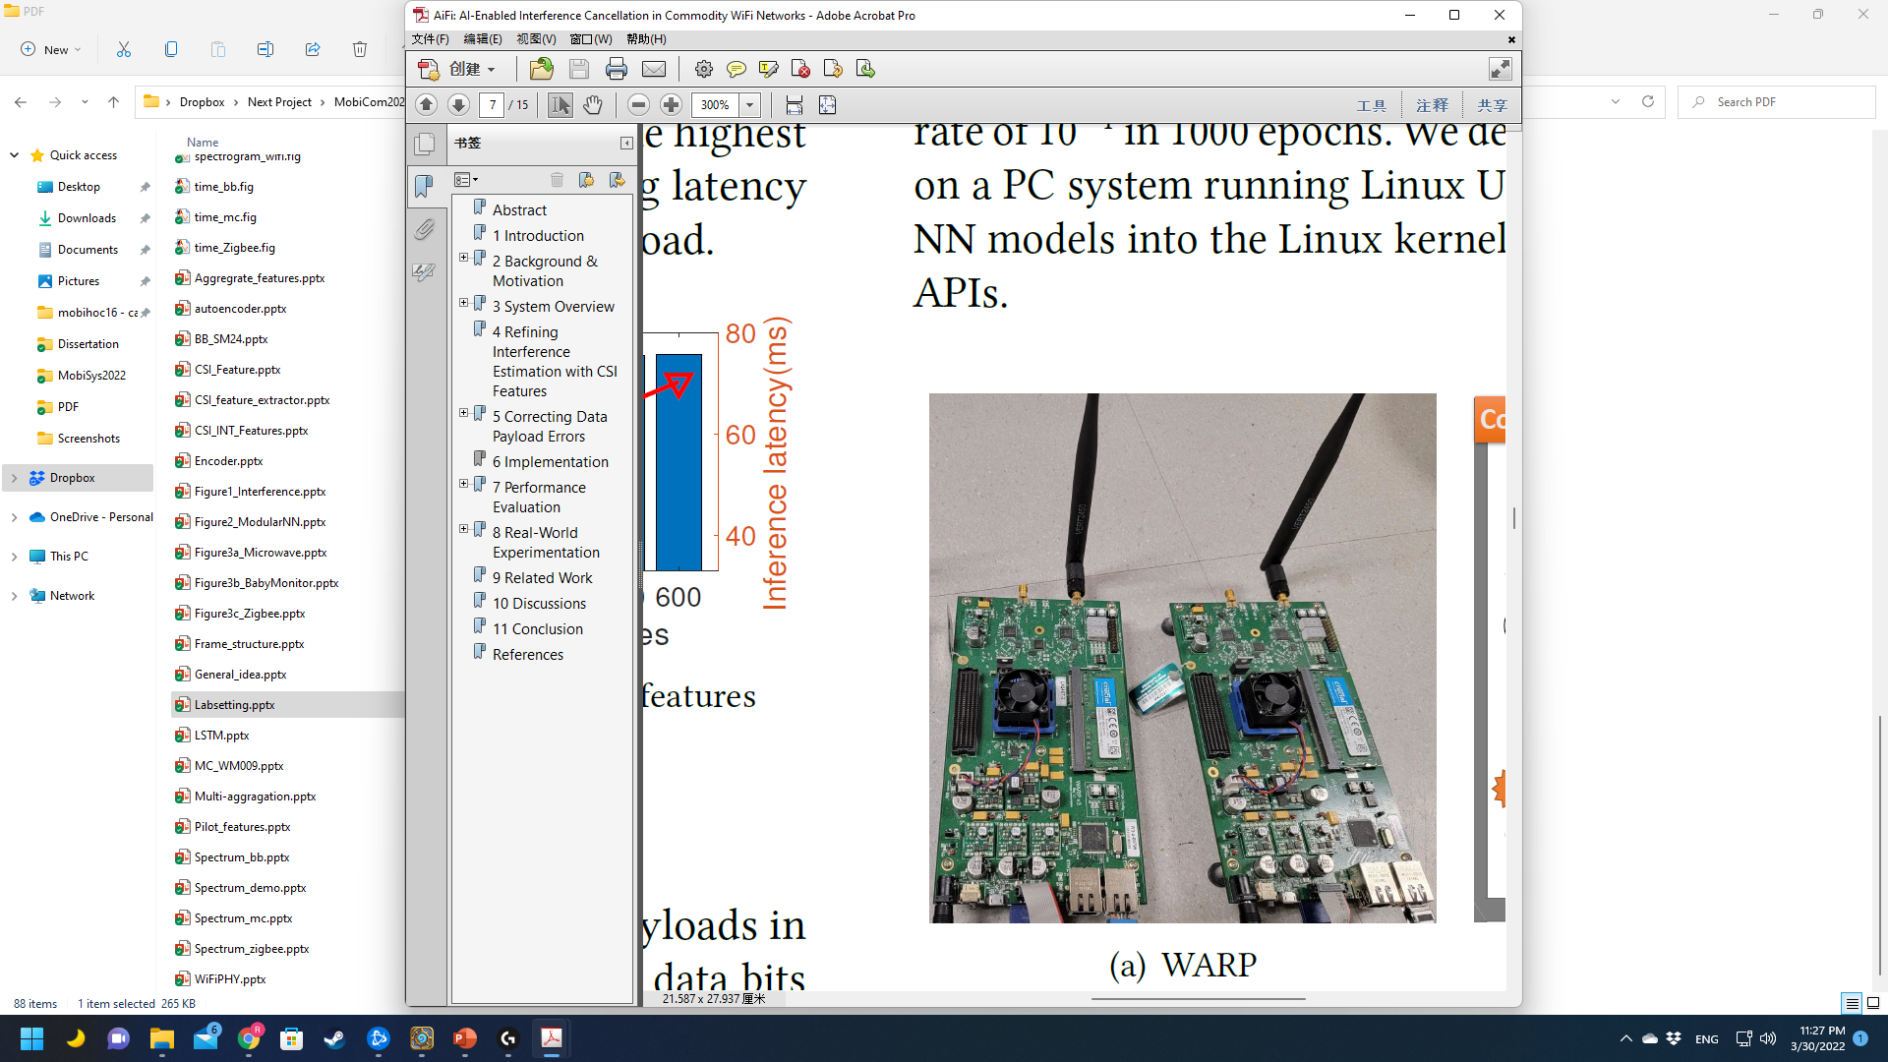
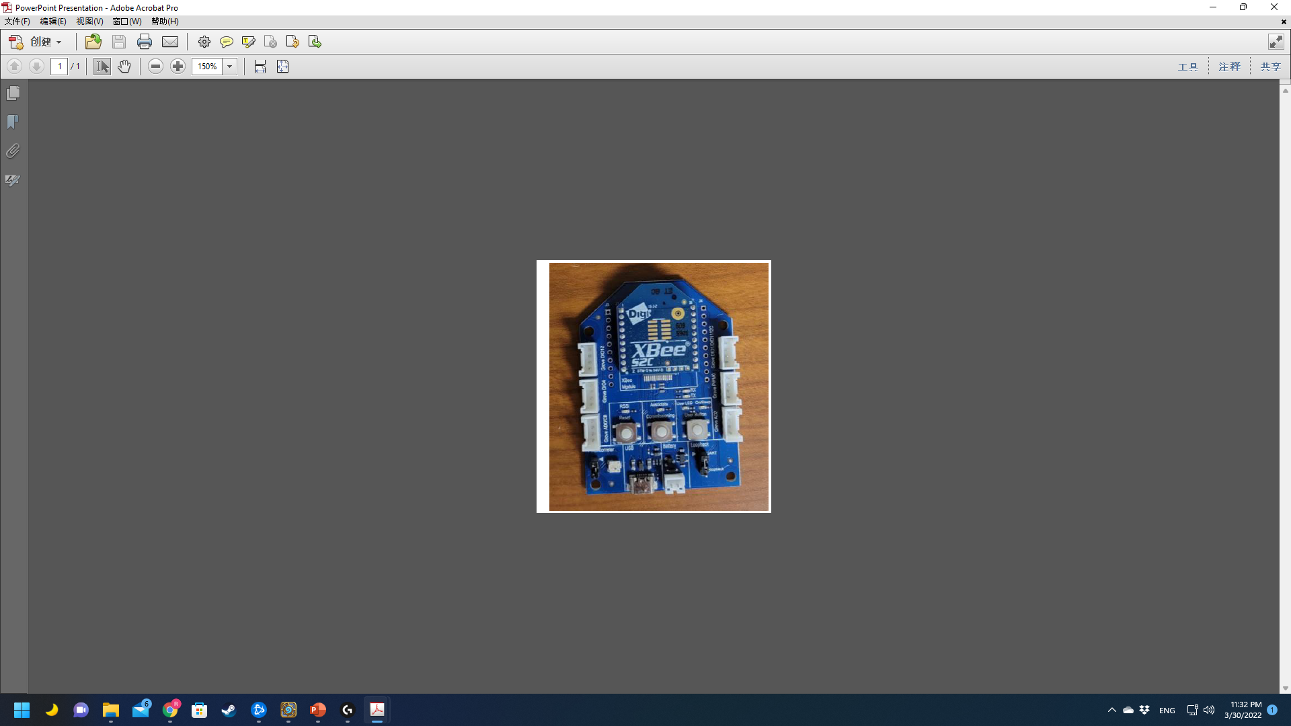
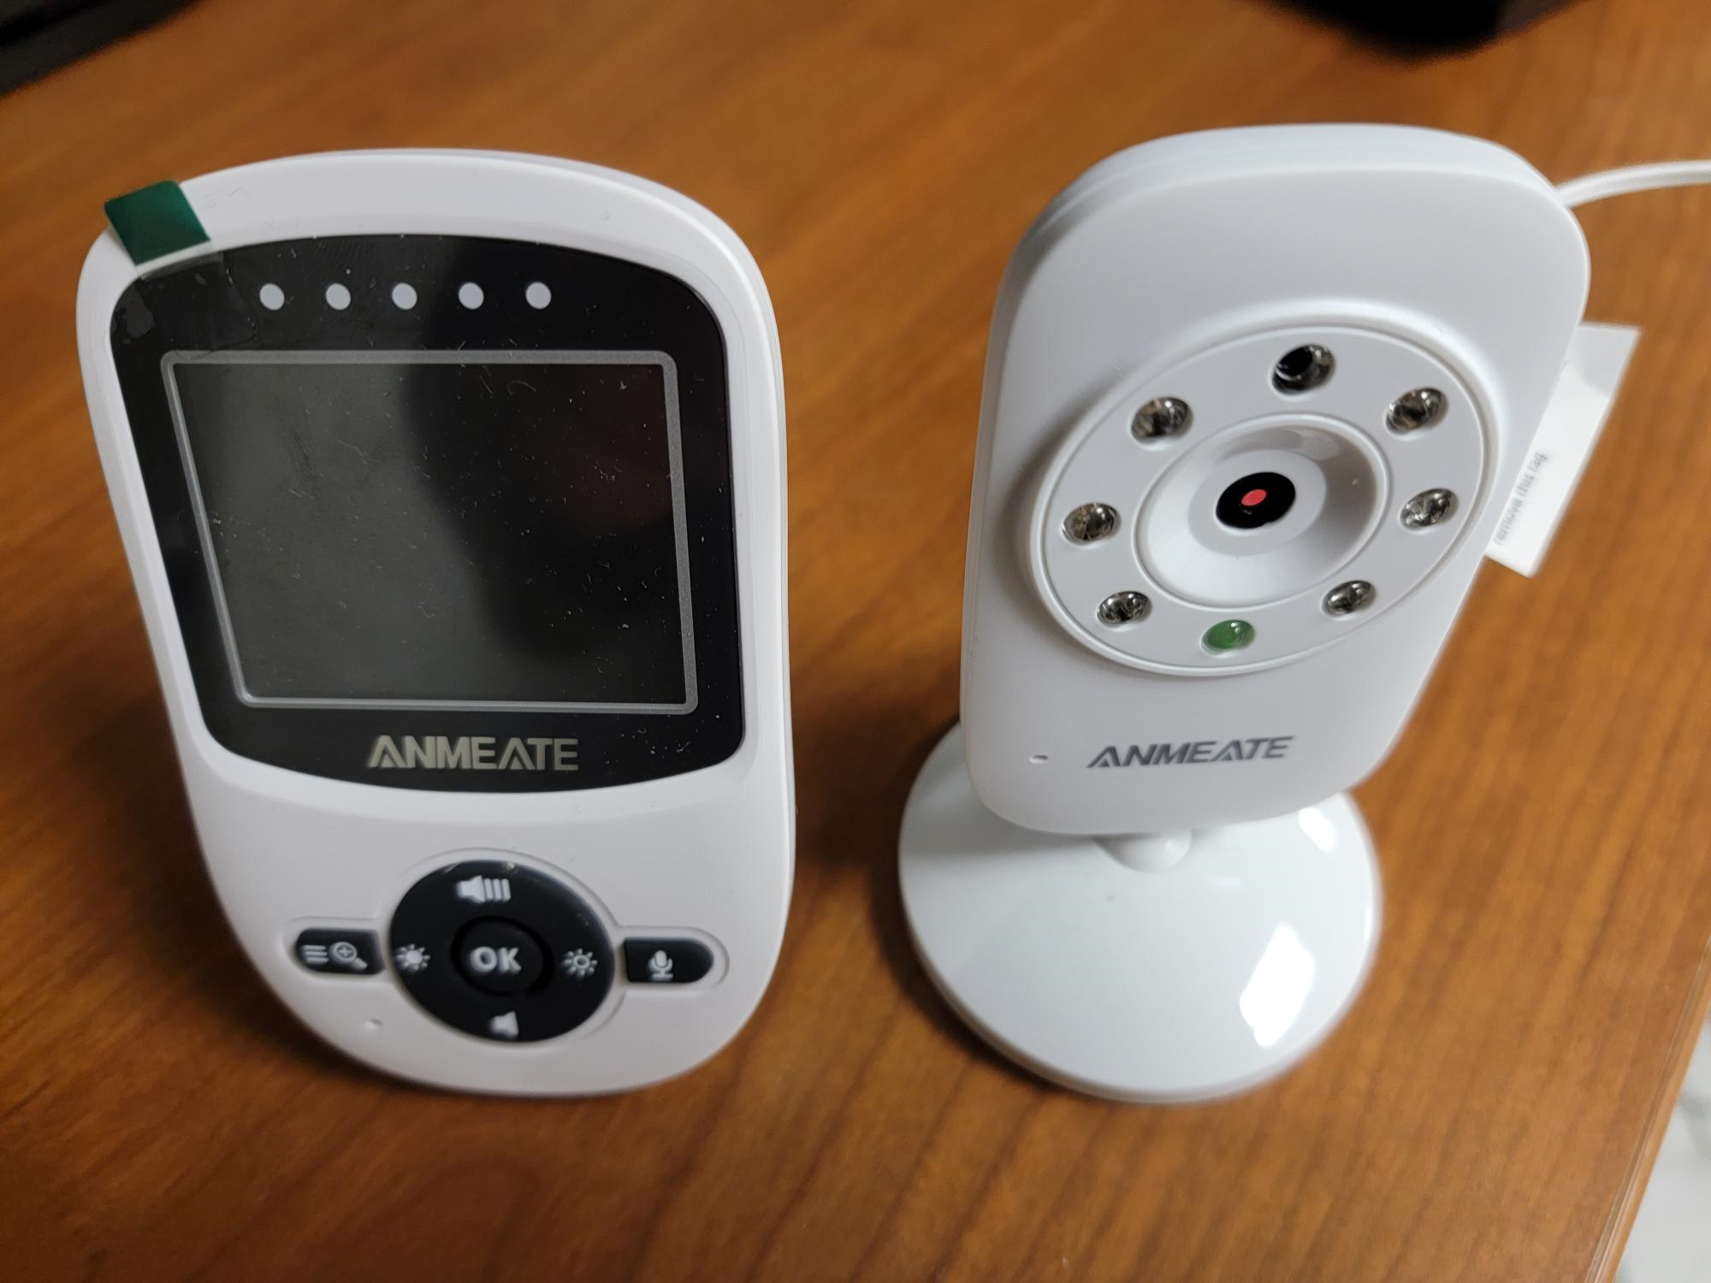
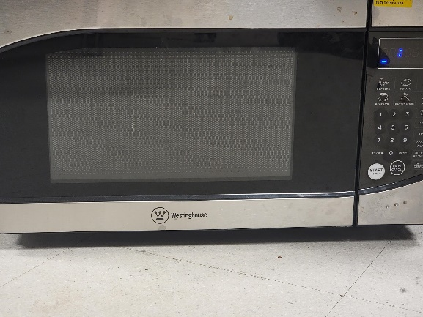
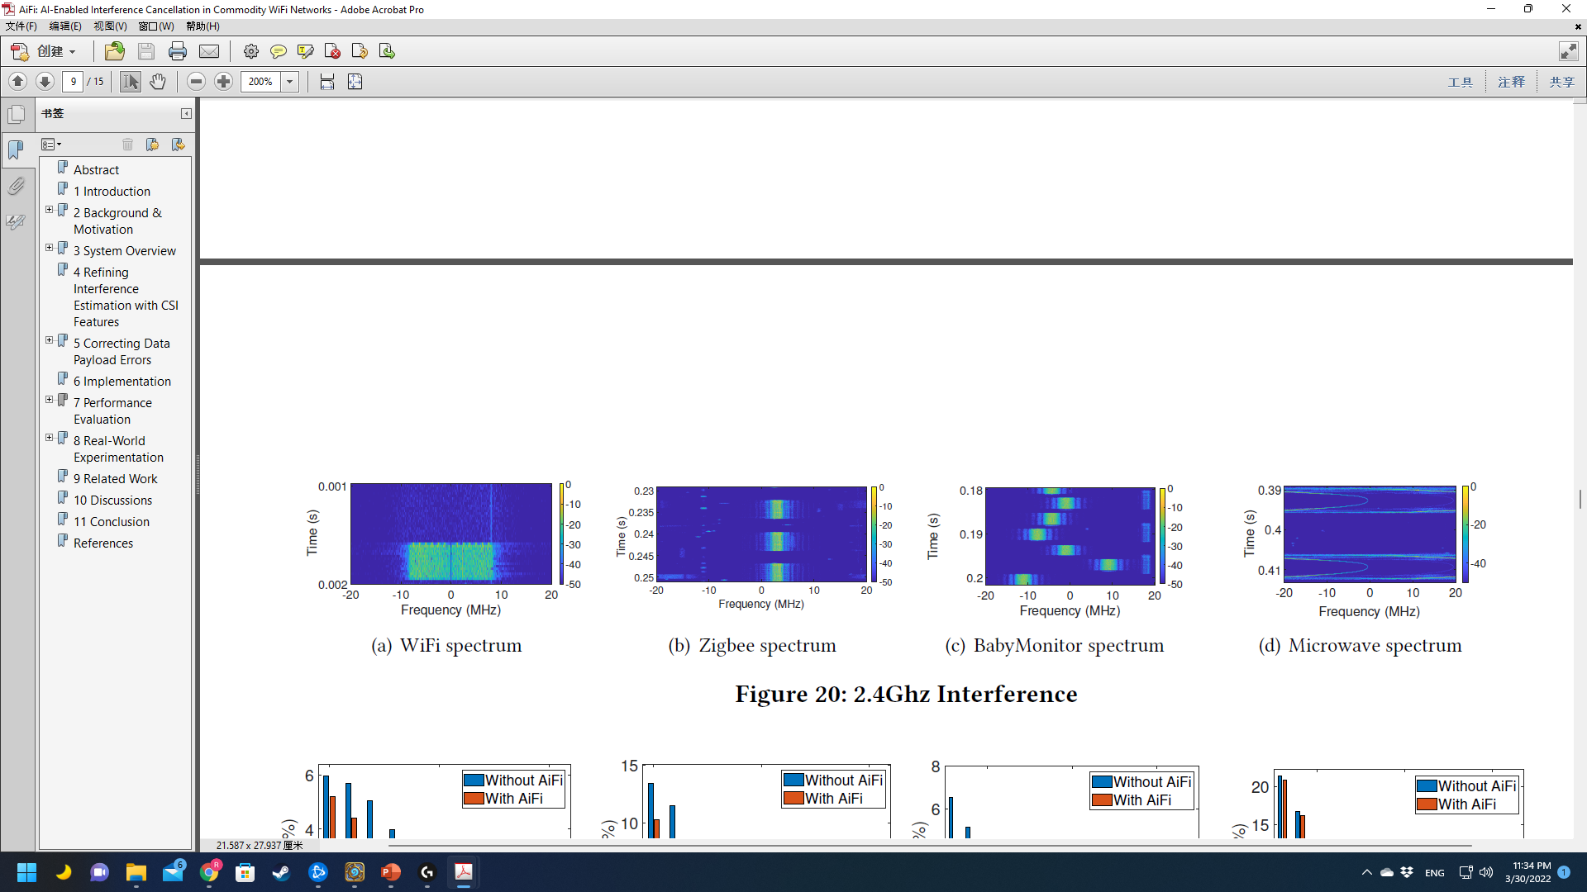
Interference Sources
WARP v3 to generate WiFi interference
Zigbee X2C module
Baby Monitor
Microwave
Notes:
In our experiments, we introduce interferences from white Gaussian noise, concurrent WiFi transmissions, commodity ZigBee transmitters, a baby monitor and a microwave oven. As shown in the spectrums, the interference patterns from these sources are very different.
For example, the WiFi and ZigBee interferences cover fixed bands, while the baby monitor transmits signals with frequency hopping patterns and the microwave oven transmits wideband continuous signals.

Slide 12
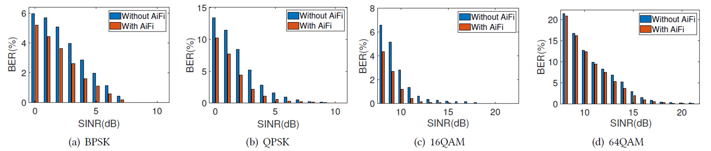
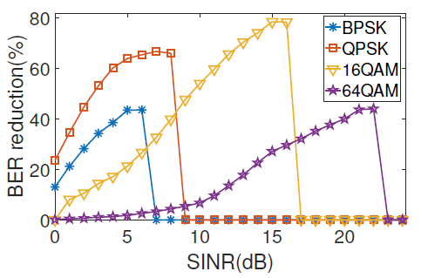
Bit Error Rate (BER) Reduction
To reach < 1% BER, AiFi reduces the minimally required SINR by > 4dB.
Correct up to 81% of bit errors
Notes:
With these interference sources, we evaluate AiFi’s bit error rate reduction under different SINR conditions and modulation schemes. The results are averaged from the experiments in all the testing sites and interference sources, with the neural network models only being trained by the WiFi interference data collected in the lab environment.
As shown in the figure, to reach below 1% of bit error rate , AiFi is able to reduce the minimum required SINR by 4dB, and correct up to 81% of bit errors.

Slide 13
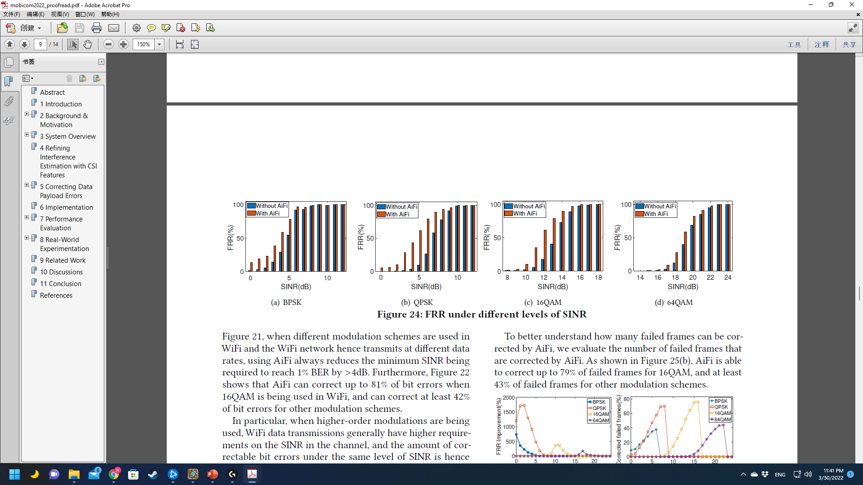
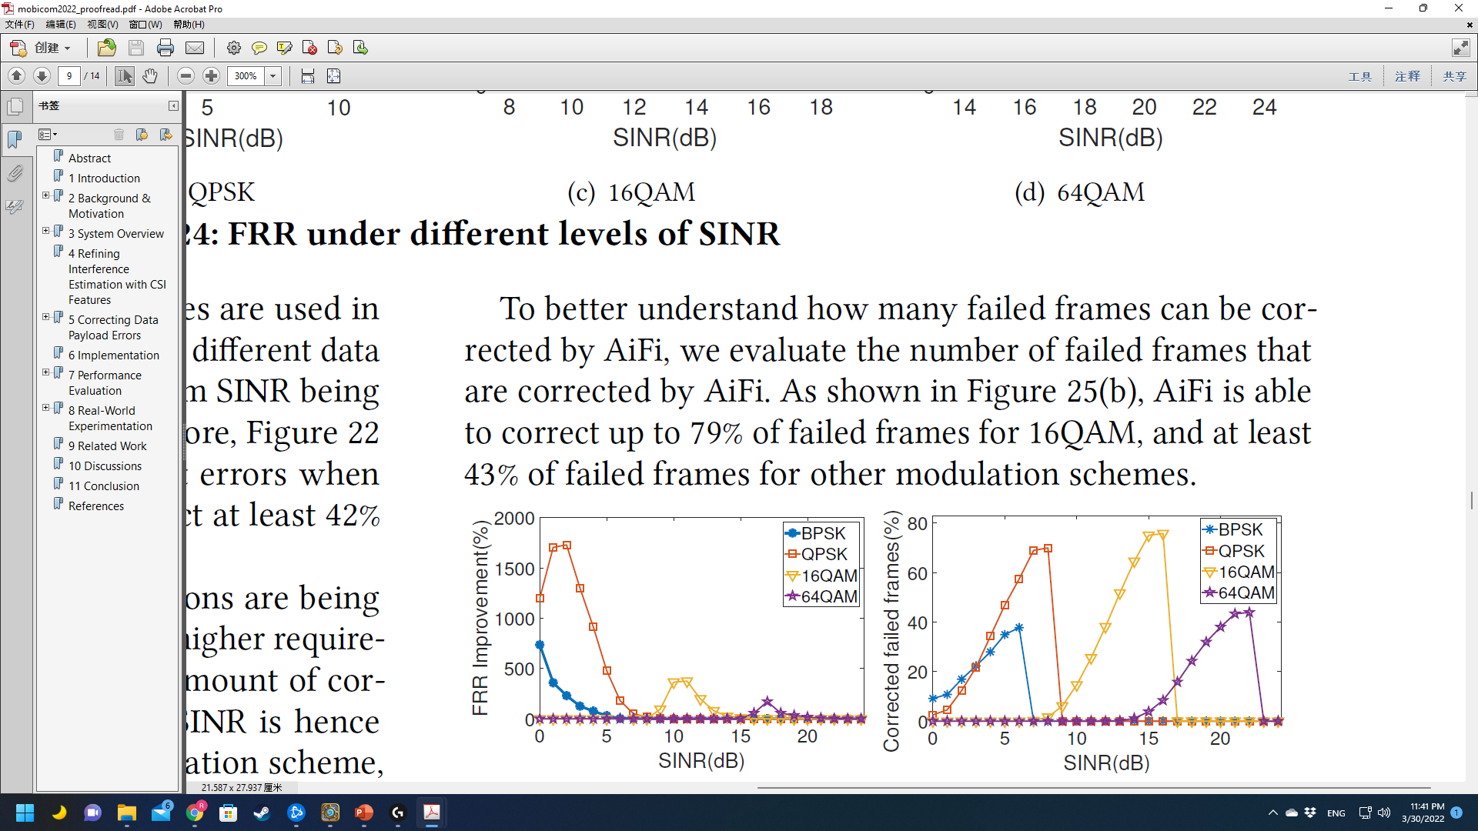
Frame Reception Rate (FRR) Improvement
To achieve 90% FRR, AiFi reduces the minimally required SINR by 3dB
Improve the FRR by 18x with QPSK at 3dB
Correct up to 79% of failed frames
Notes:
We also evaluate AiFi’s performance in improving the frame reception rate.
Our results show that, to achieve over 90% of frame reception rate, AiFi is able to reduce the minimally required SINR by 3dB and correct up to 79% of failed frames.
Particularly, when using QPSK, AiFi can improve the frame reception rate by 18 times at 3dB of SINR.

Slide 14
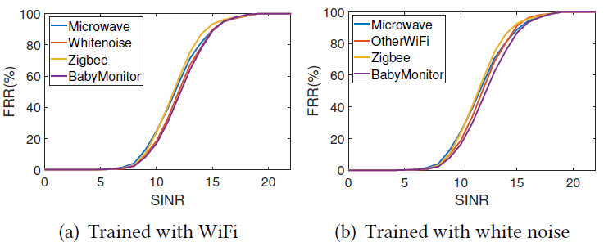
Generality of AiFi
AiFi can be generally applicable to interference signals with different patterns
Notes:
As previously mentioned, once being trained, we expect that AiFi can be generically applied to different scenarios without retraining.
To verify such generality, we train AiFi in lab environment with concurrent WiFi transmission and gaussian white noise. And then test AiFi in other testing sites with different interference sources.
Our results show that AiFi can maintain its interference cancellation power, which demonstrates AiFi can be generally applied to different interference patterns.

Slide 15
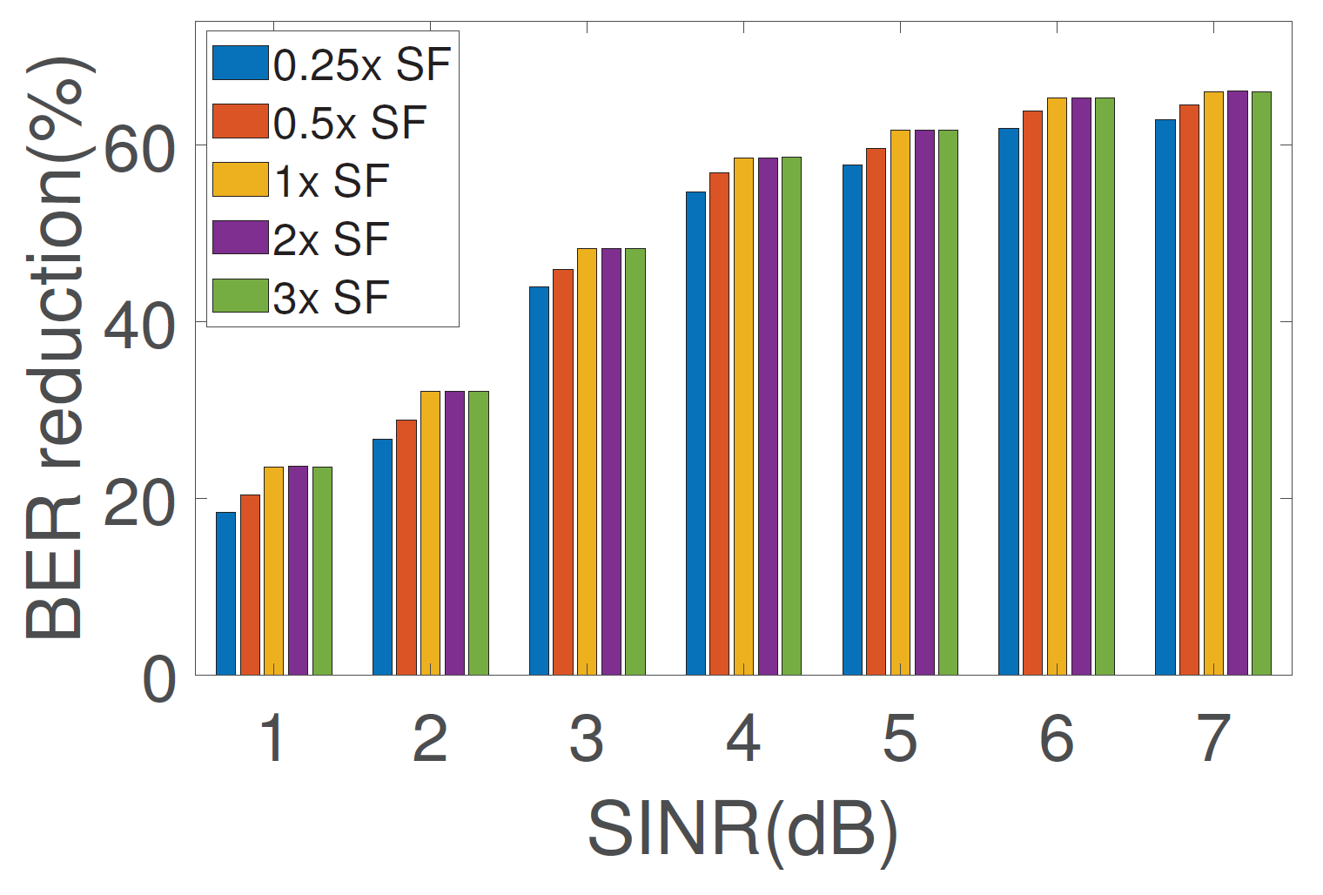
Impact of AiFi’s NN Complexity
Scaling Factor (SF) controls number of features
AiFi can fit to different resource constraints with little performance drop
Notes:
We also studied the impact of NN complexity on AiFi’s performance.
The NN complexity is controlled by scaling the number of features in each NN layer.
Our results show that, by scaling the NN complexity, AiFI can fit into different resource constraints with little performance drop.

Slide 16
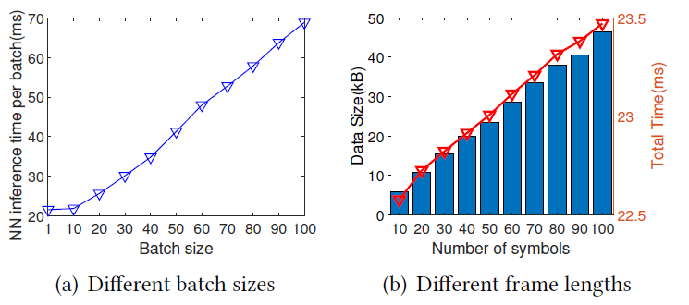
Latency of AiFi’s NN inference
Minimal latency = 0.7ms per frame
Notes:
On the other hand, the NN inference time should be sufficiently low to meet the timing constraint in WiFi physical layer.
In our experiments, we evaluate the latency of AiFi’s NN inference with different batch sizes and frame lengths.
As shown in the figure, when a large batch size of 100 is used, AiFi’s per-frame inference latency is less than 1ms.
Such batch-based frame processing is common in WiFi g/n/ac networks with automatic repeat request,
On the other hand, with batch size of 1, AiFi’s inference time only increases < 1ms when the frame length varies from 10 to 100 symbols.

Slide 17
Summary
AiFi enables WiFi interference cancellation at commodity WiFi devices without requiring any extra RF hardware.
AiFi utilizes the domain knowledge of commodity PHY operations to guide the neural network designs
AiFi can reduce BER due to interference by up to 80% and improve the WiFi FRR by up to 18x.
Notes:
To summarize, …

Slide 18
Thank you!
Questions?
Notes:
This is the end my presentation, thank you for listening!

